Slide 1
6 Plot presentation
By: Nana Prempeh & Victor Adekola

Slide 2
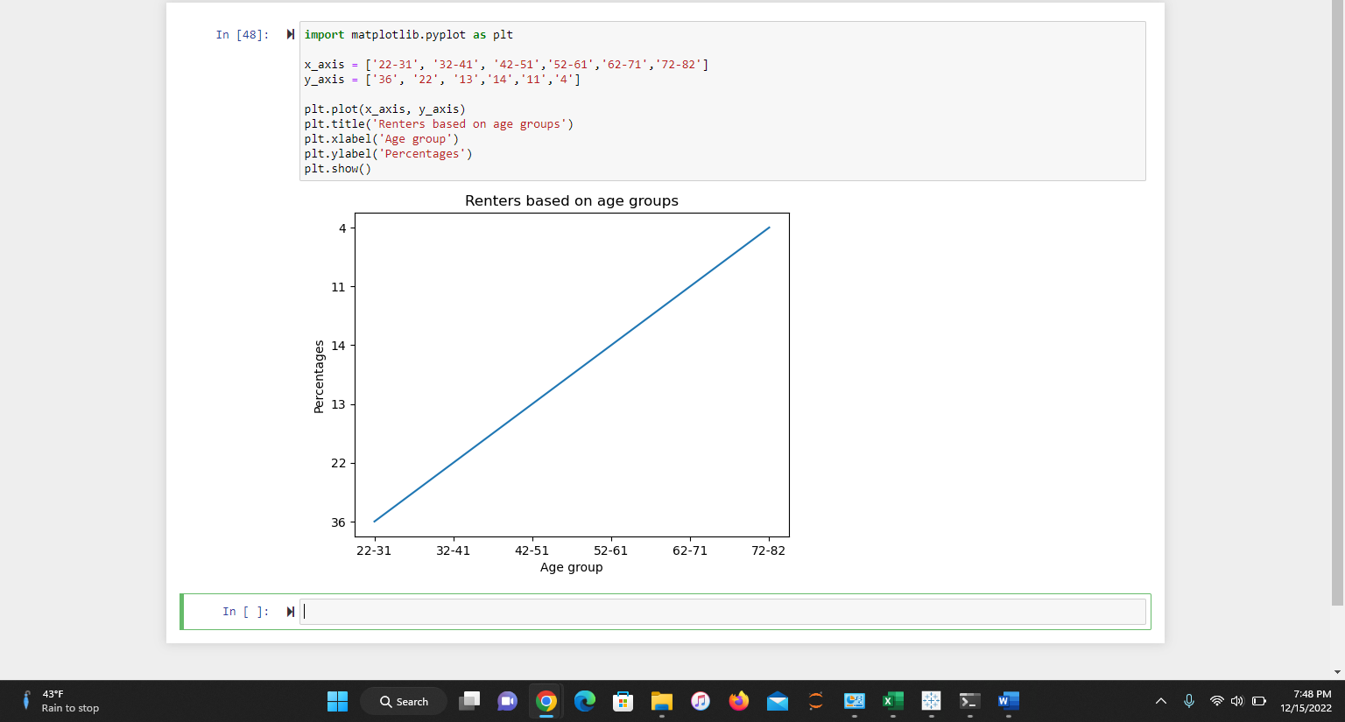
Line plot
About 36% of households preferred renting, and they are people who are between the ranges of 22-31. They are followed by individuals under the age of 32 and 41 in renting housing units, especially when they stay. On the other hand, Individuals owning houses stand at 23%, and the majority of these people fall under the age bracket of 52-61.

Slide 3
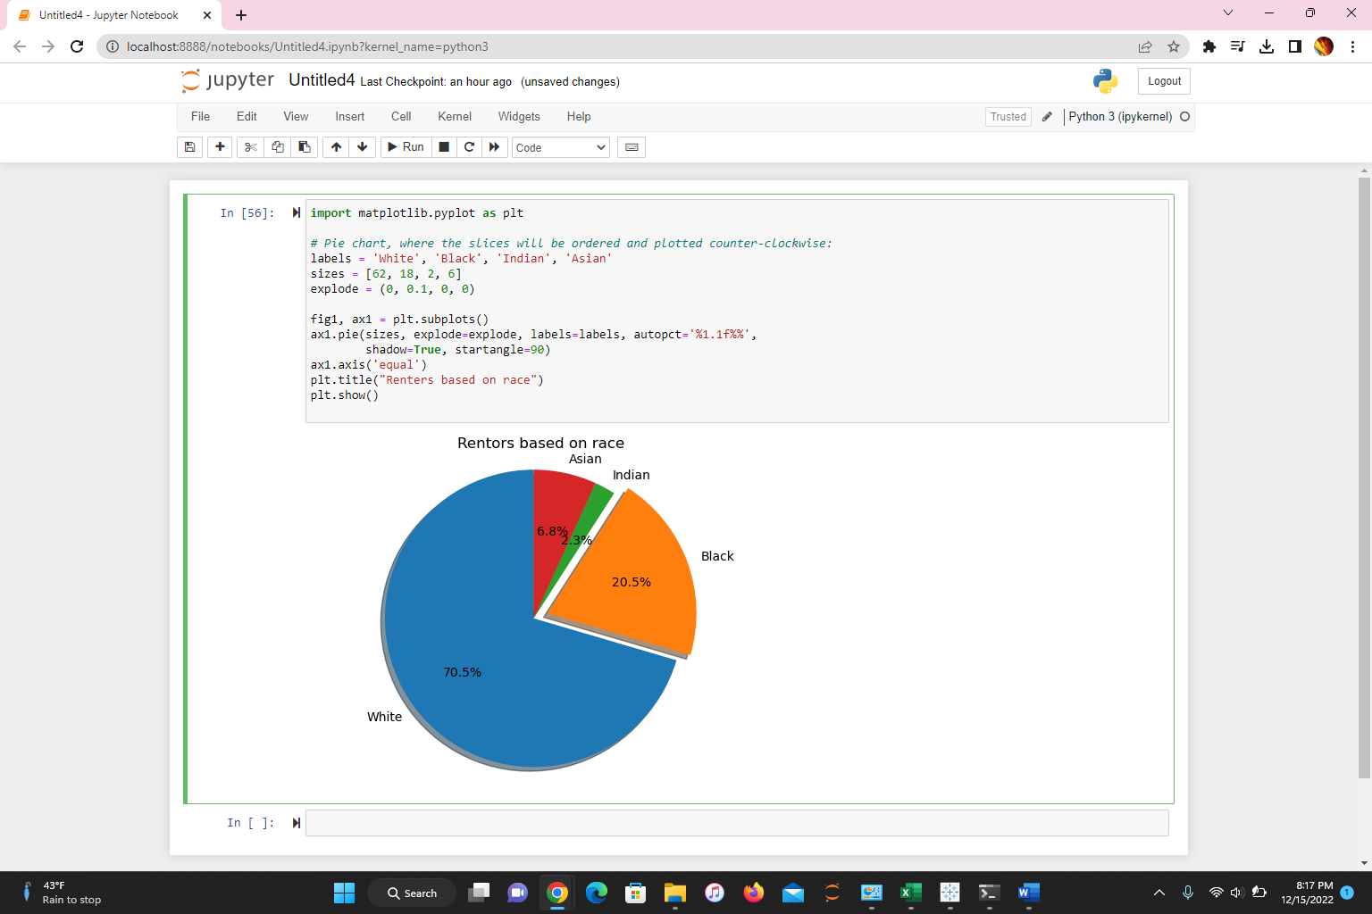
Pie Plot
Black and Hispanic individuals have about twice as likely as white people to rent their housing units. Whites lead in both homeowners and renters with 77% and 62%. These statistics could be different and most important when major racial and ethnic groups can rent housing units. Therefore, an increase in the rental rates will affect several families.

Slide 4
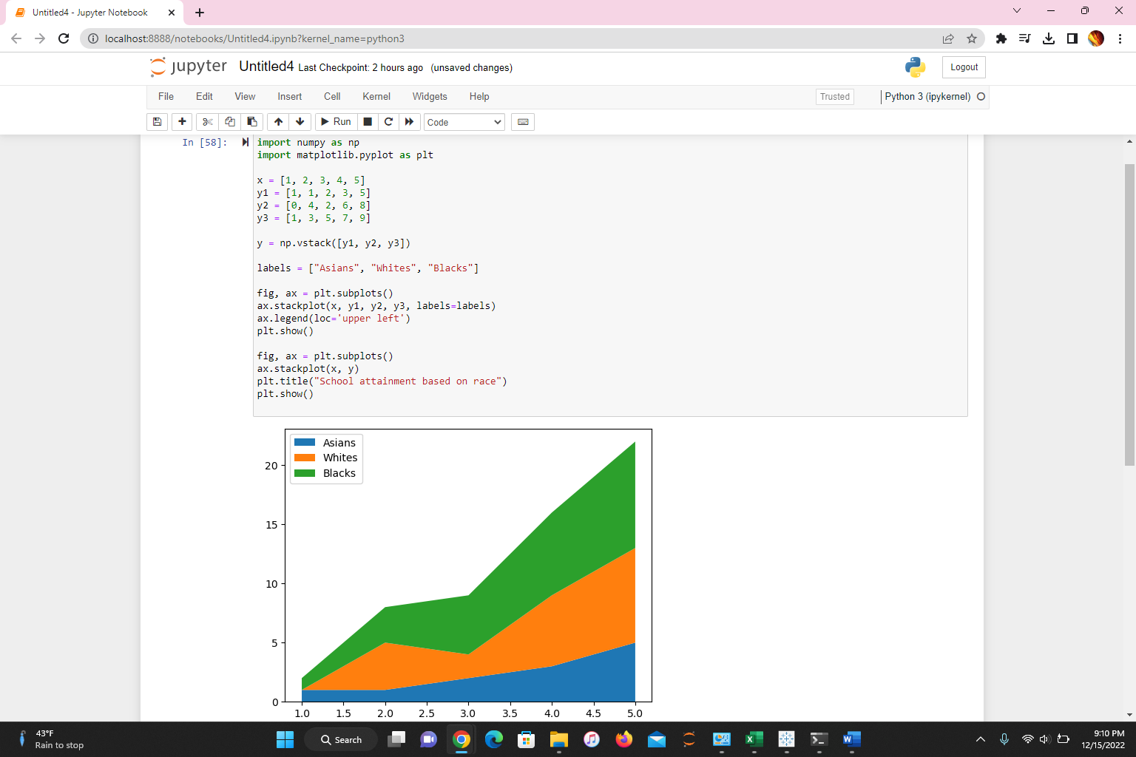
Stackplot
The movement toward homeowners and renting is also affected all levels of educational achievement. Ideally, from 2006 to 2019, rental rates have been increased among many people headed with someone who did not finish high school. College graduates tend more towards renting instead of owning housing units. The holders of Bachelor's Degree has 31% as a homeowner and renting at 30%. The margin is close; the homeowner is higher than renting

Slide 5
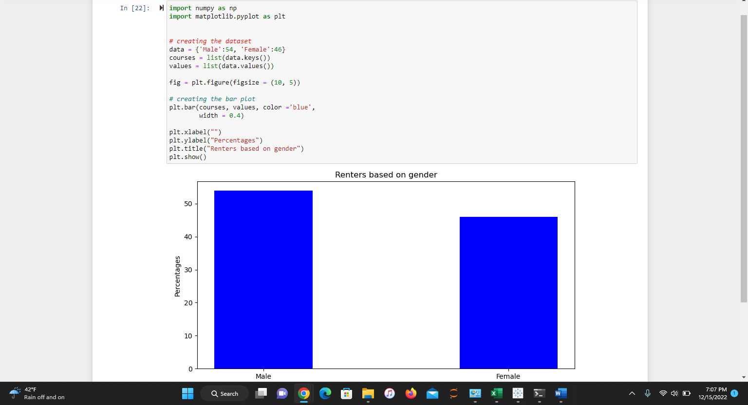
Bar plot
There is a significant difference based on gender. The male gender seems to be higher than the female gender in both homeownership and renting. Males have 55% for homeownership and 54% for renting. At the same time, females have 46% for rental and 45% for homeownership.

Slide 6
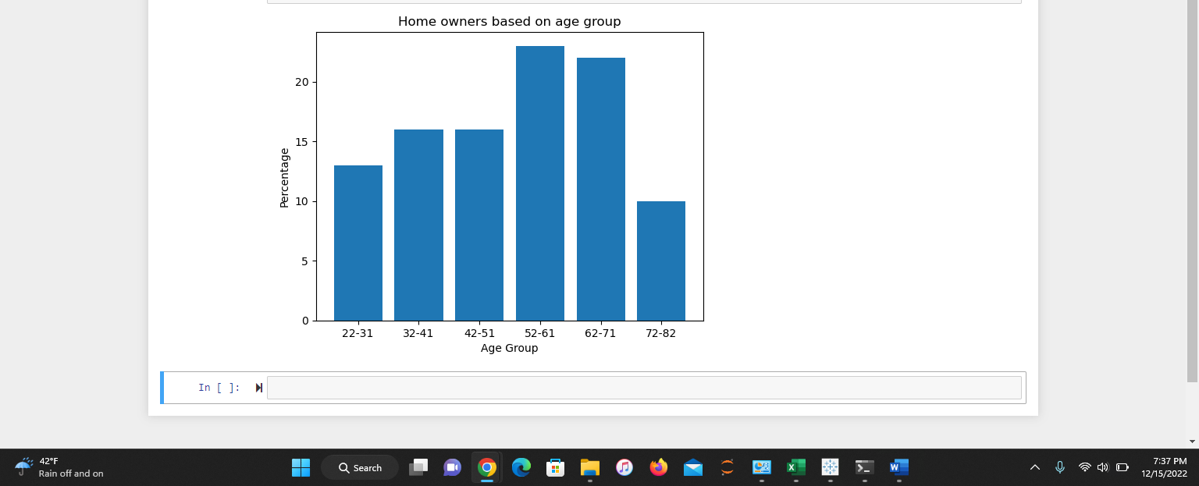
Bar plot matplotlib
About 36% of households preferred renting, and they are people who are between the ranges of 22-31. They are followed by individuals under the age of 32 and 41 in renting housing units, especially when they stay. On the other hand, Individuals owning houses stand at 23%, and the majority of these people fall under the age bracket of 52-61.
Python code: import matplotlib.pyplot as plt
age_group = ['22-31', '32-41', '42-51', '52-61', '62-71', '72-82']
percentage = [13,16.16,23,22,10]
plt.bar(age_group, percentage)
plt.title('Home owners based on age group')
plt.xlabel('Age Group')
plt.ylabel('Percentage')
plt.show()

Slide 7
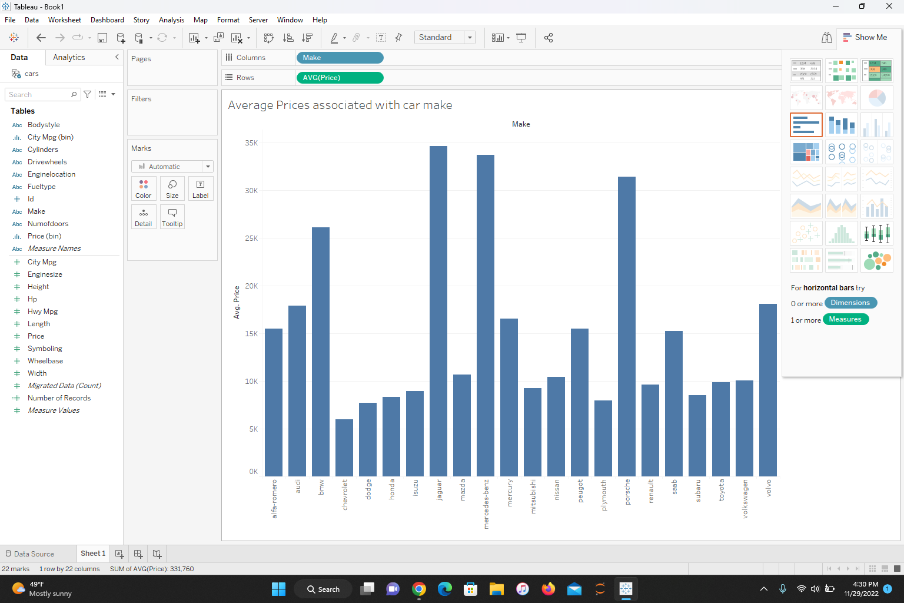
Histogram plot

